Slide 1
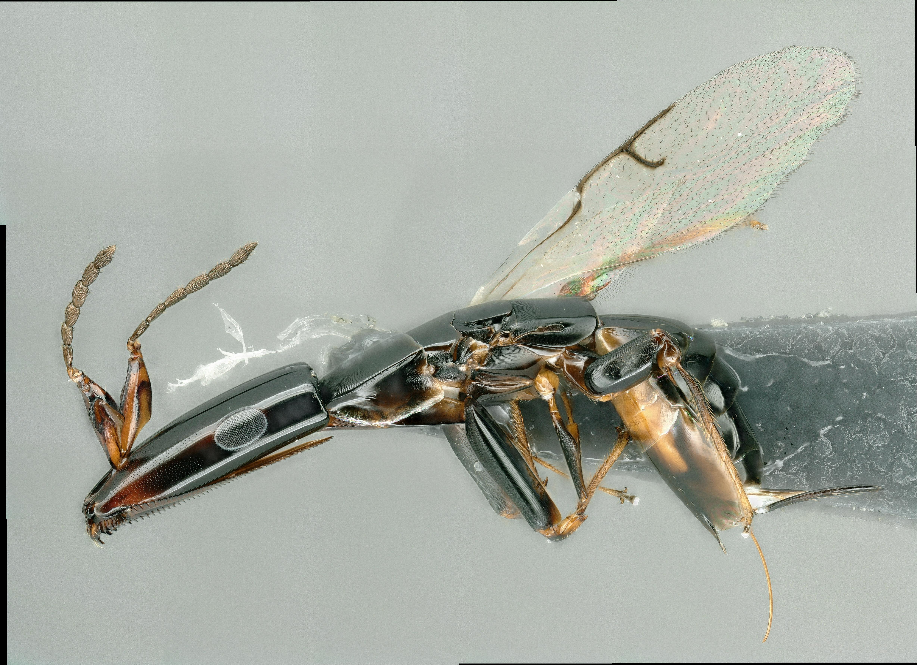
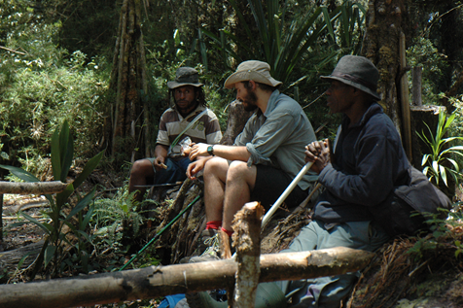
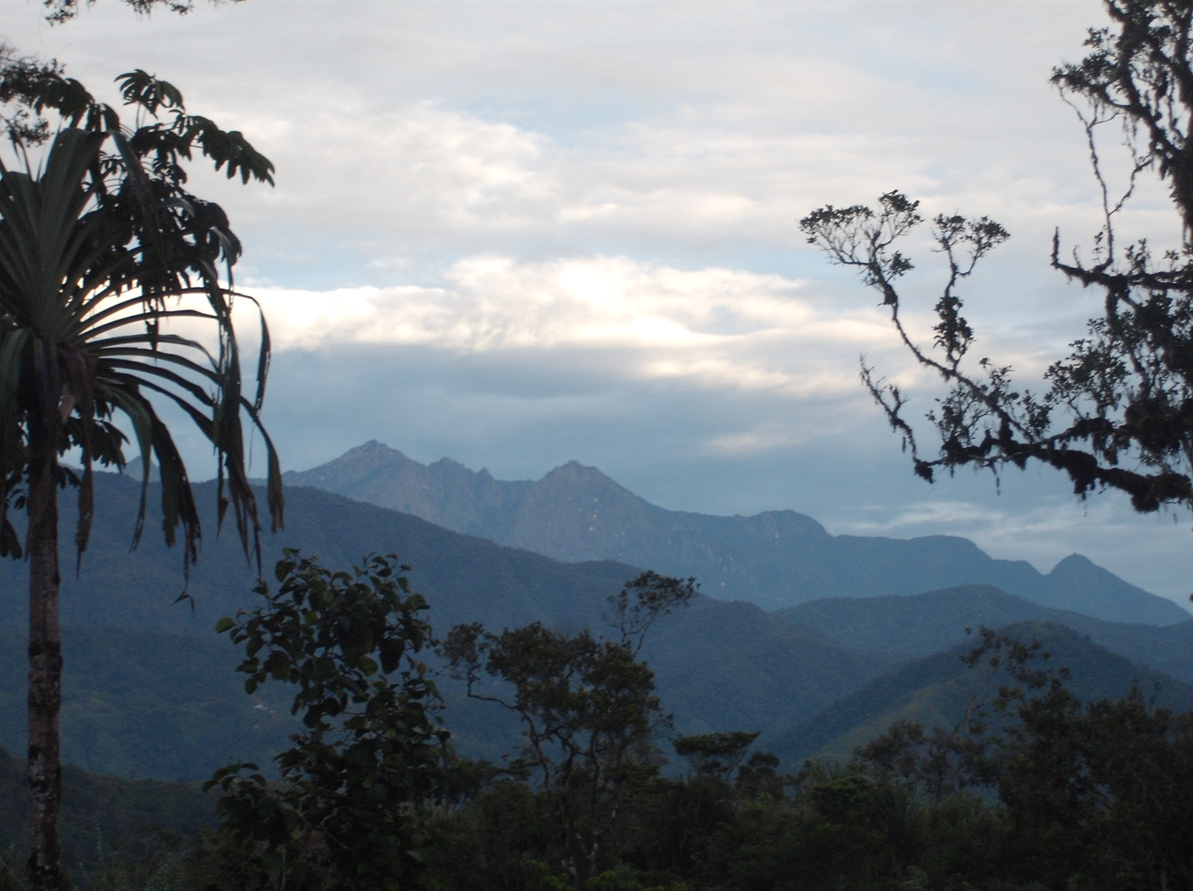
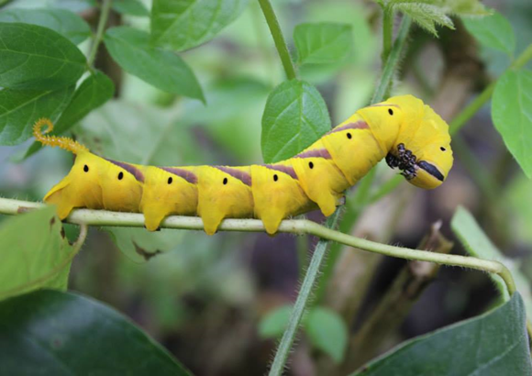
Summary of Interests
Dr Simon Segar
08/07/24
Senior Lecturer in Entomology, Harper Adams University

Slide 2
Short CV
BSc University College, London (2004)
MSc Imperial College, London (2006)
PhD University of Reading (2011)
Post-doc, Czech Academy of Sciences (2012-2015)
Lab Leader, Czech Academy of Sciences (2015-2018)
Lecturer in Entomology, Harper Adams University (2018-present)
https://scholar.google.co.uk/citations?user=wmgHD2kAAAAJ&hl=en

Slide 3
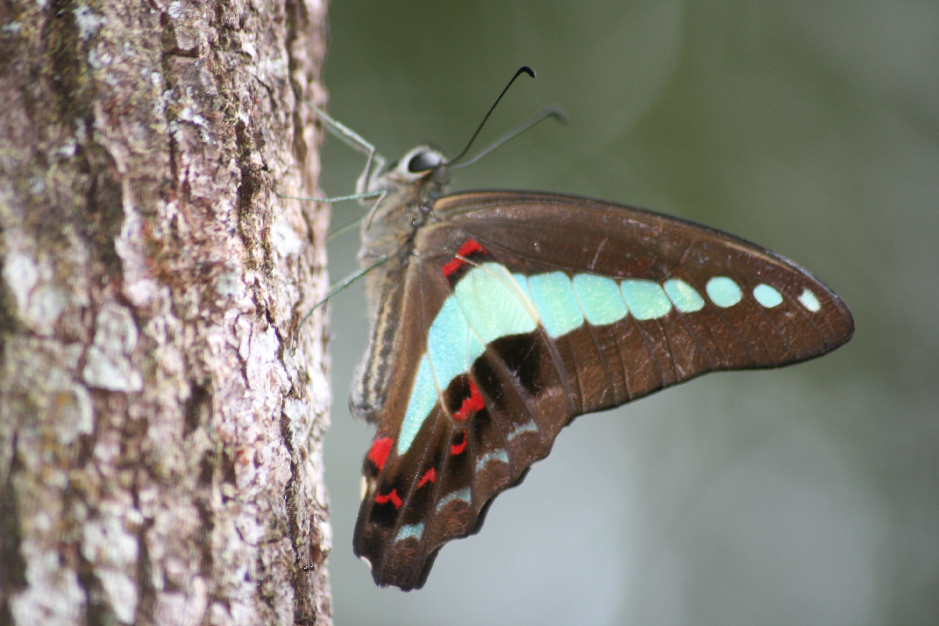
Route into Entomology
Interest
Academic training
Curiosity
Outreach
Luck
Networking
Hard work
Tropical entomology
MSc and PhD
Working with the right people

Slide 4
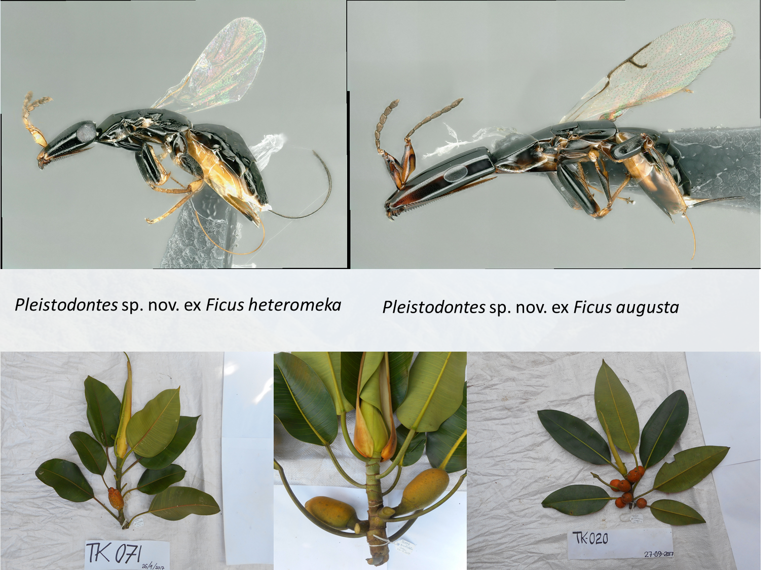

Slide 5
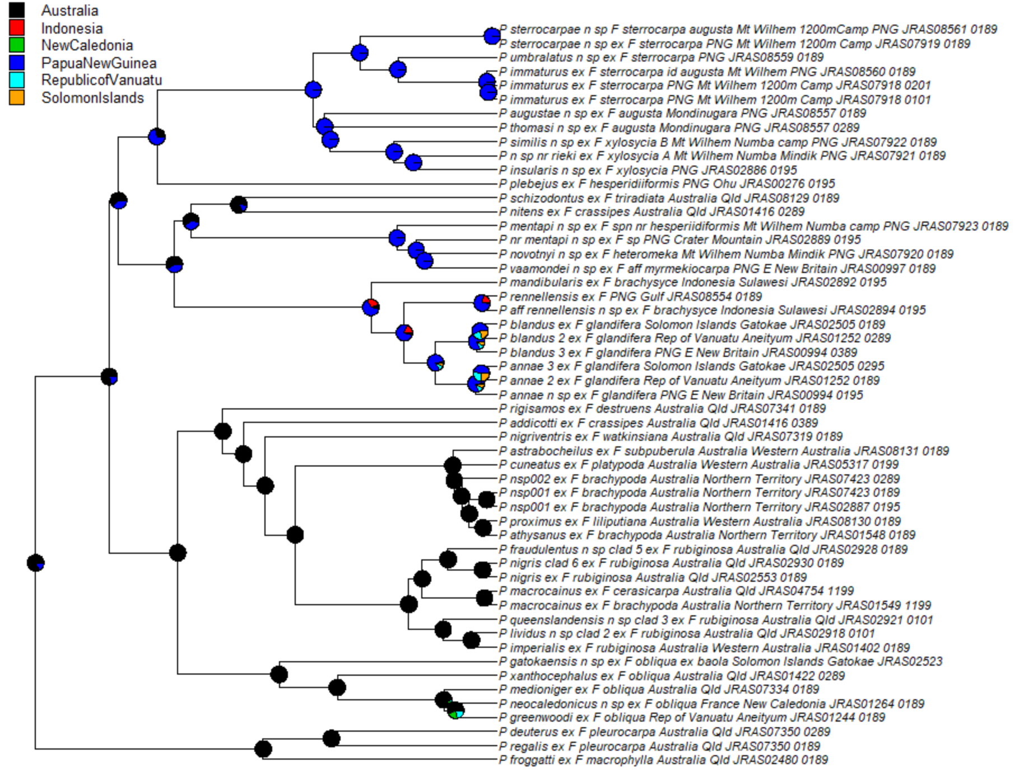

Slide 6
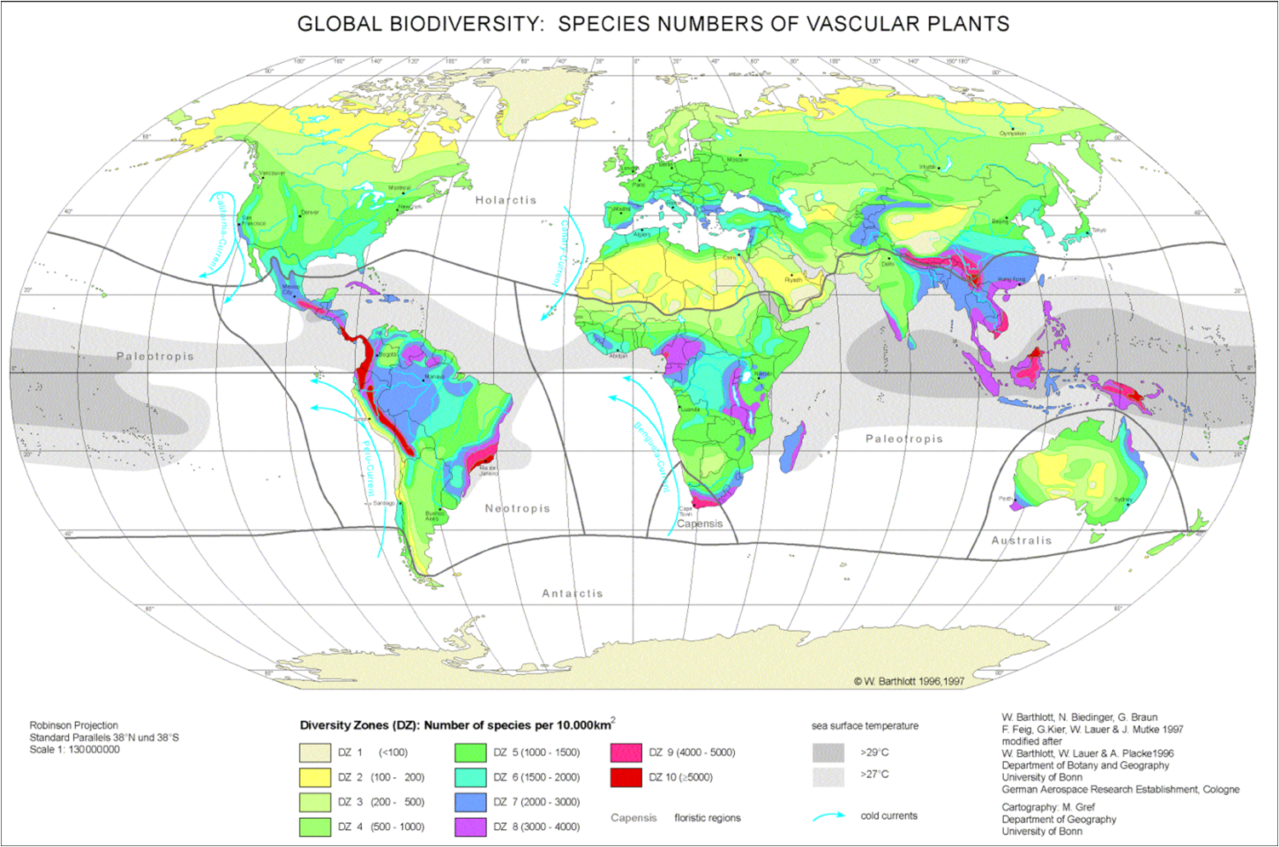
Tropical Mountains are Biodiversity Hotspots

Slide 7

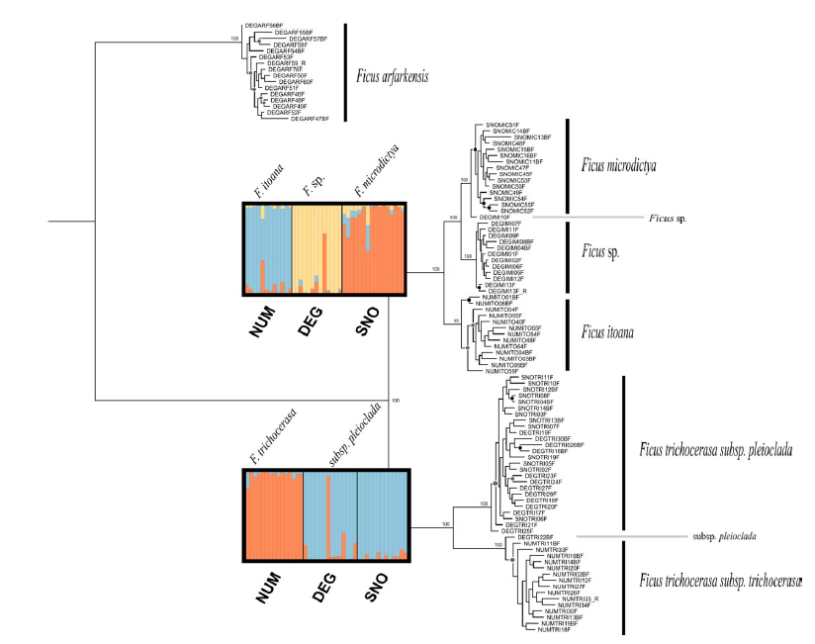
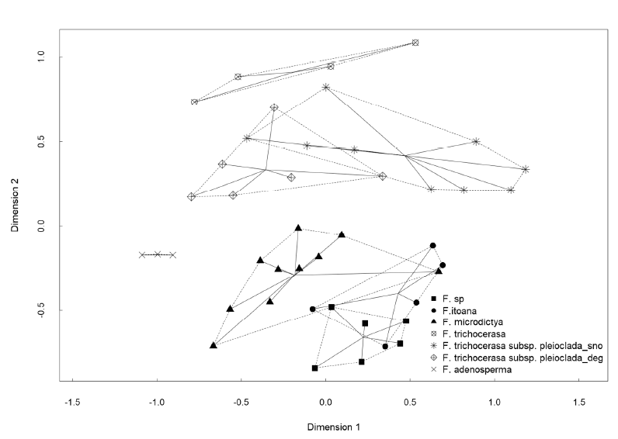
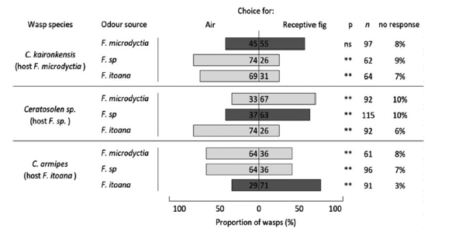

Slide 8
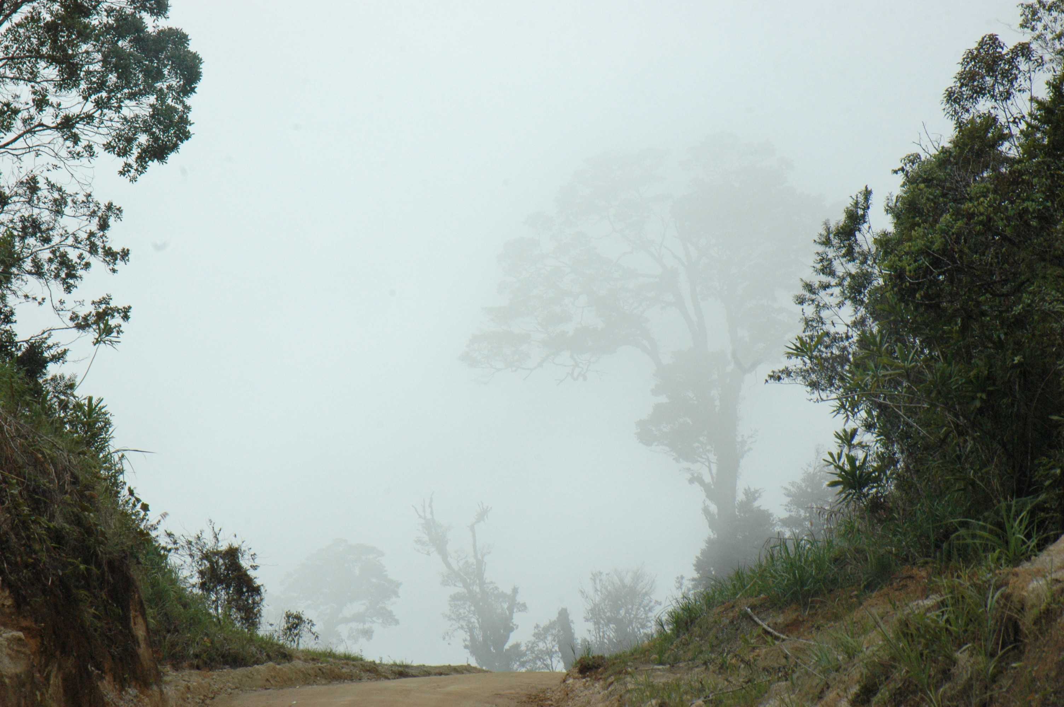
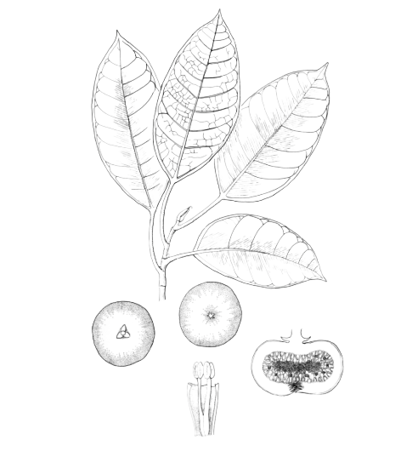
New species of fig described in 2019…along with a new breeding system for the genus: Ficus umbrae
“From classical Latin umbra- ‘shadow’ or alluding to a forest spirit. The name recognises Wanamo, the dog-headed spirit or masalai regarded by the people of Degenumbu as the guardian of their forests, the type locality of this species”.
Ezedin and Weiblen (2019)
Ezedin and Weiblen, 2019. Gard. Journ. Sing.

Slide 9
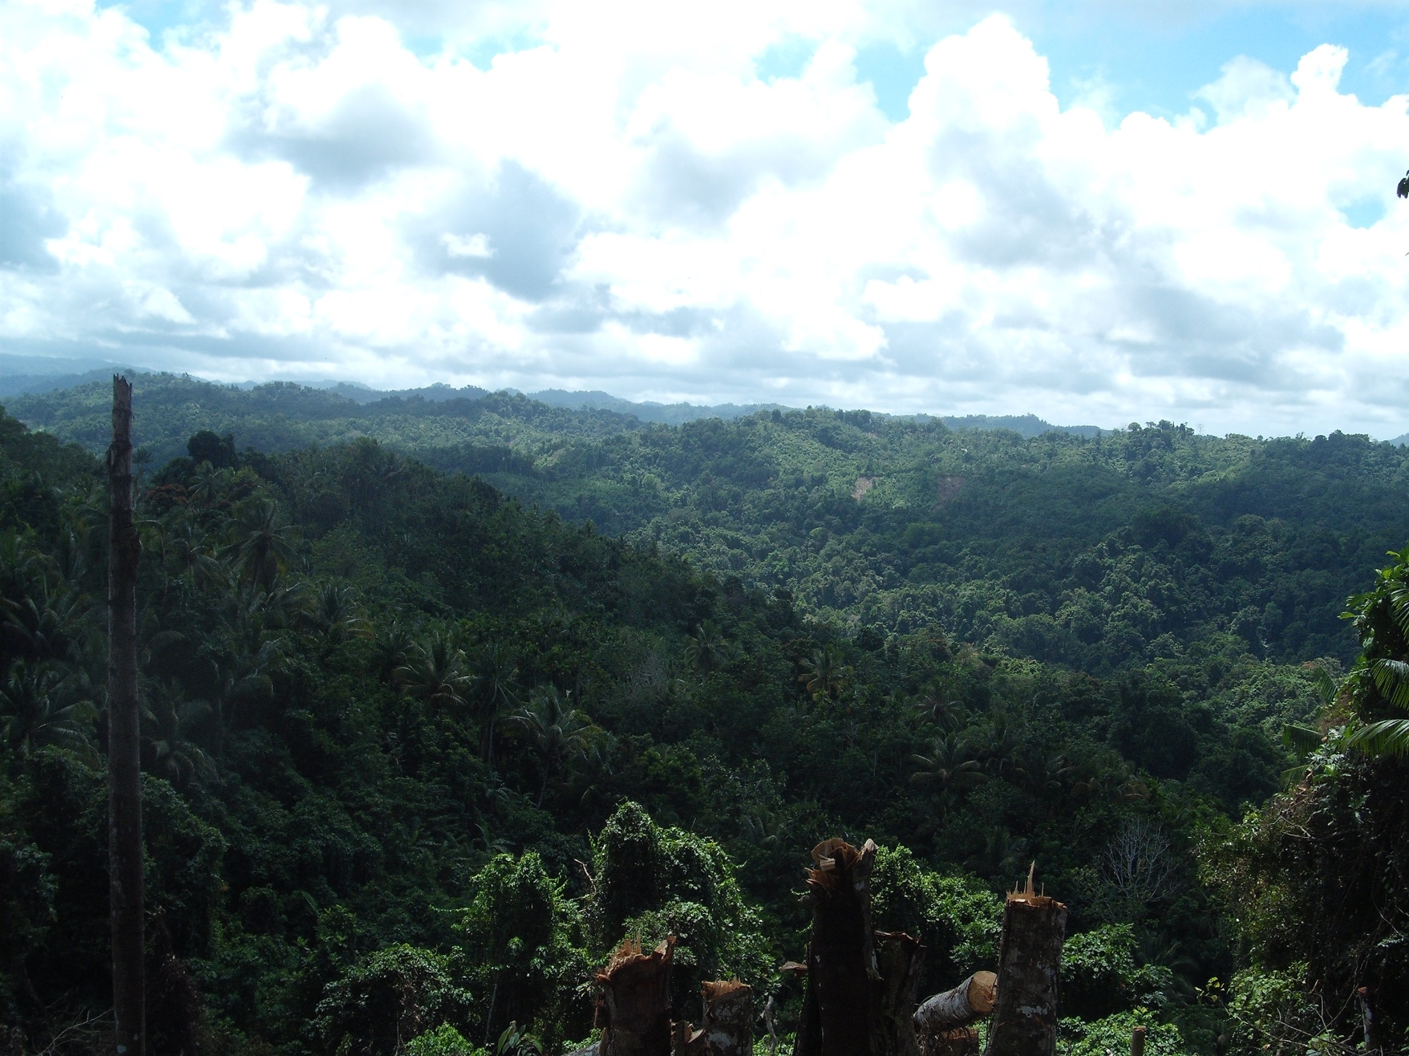

Slide 10

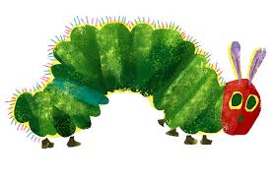
Probability of Occurrence

Slide 11
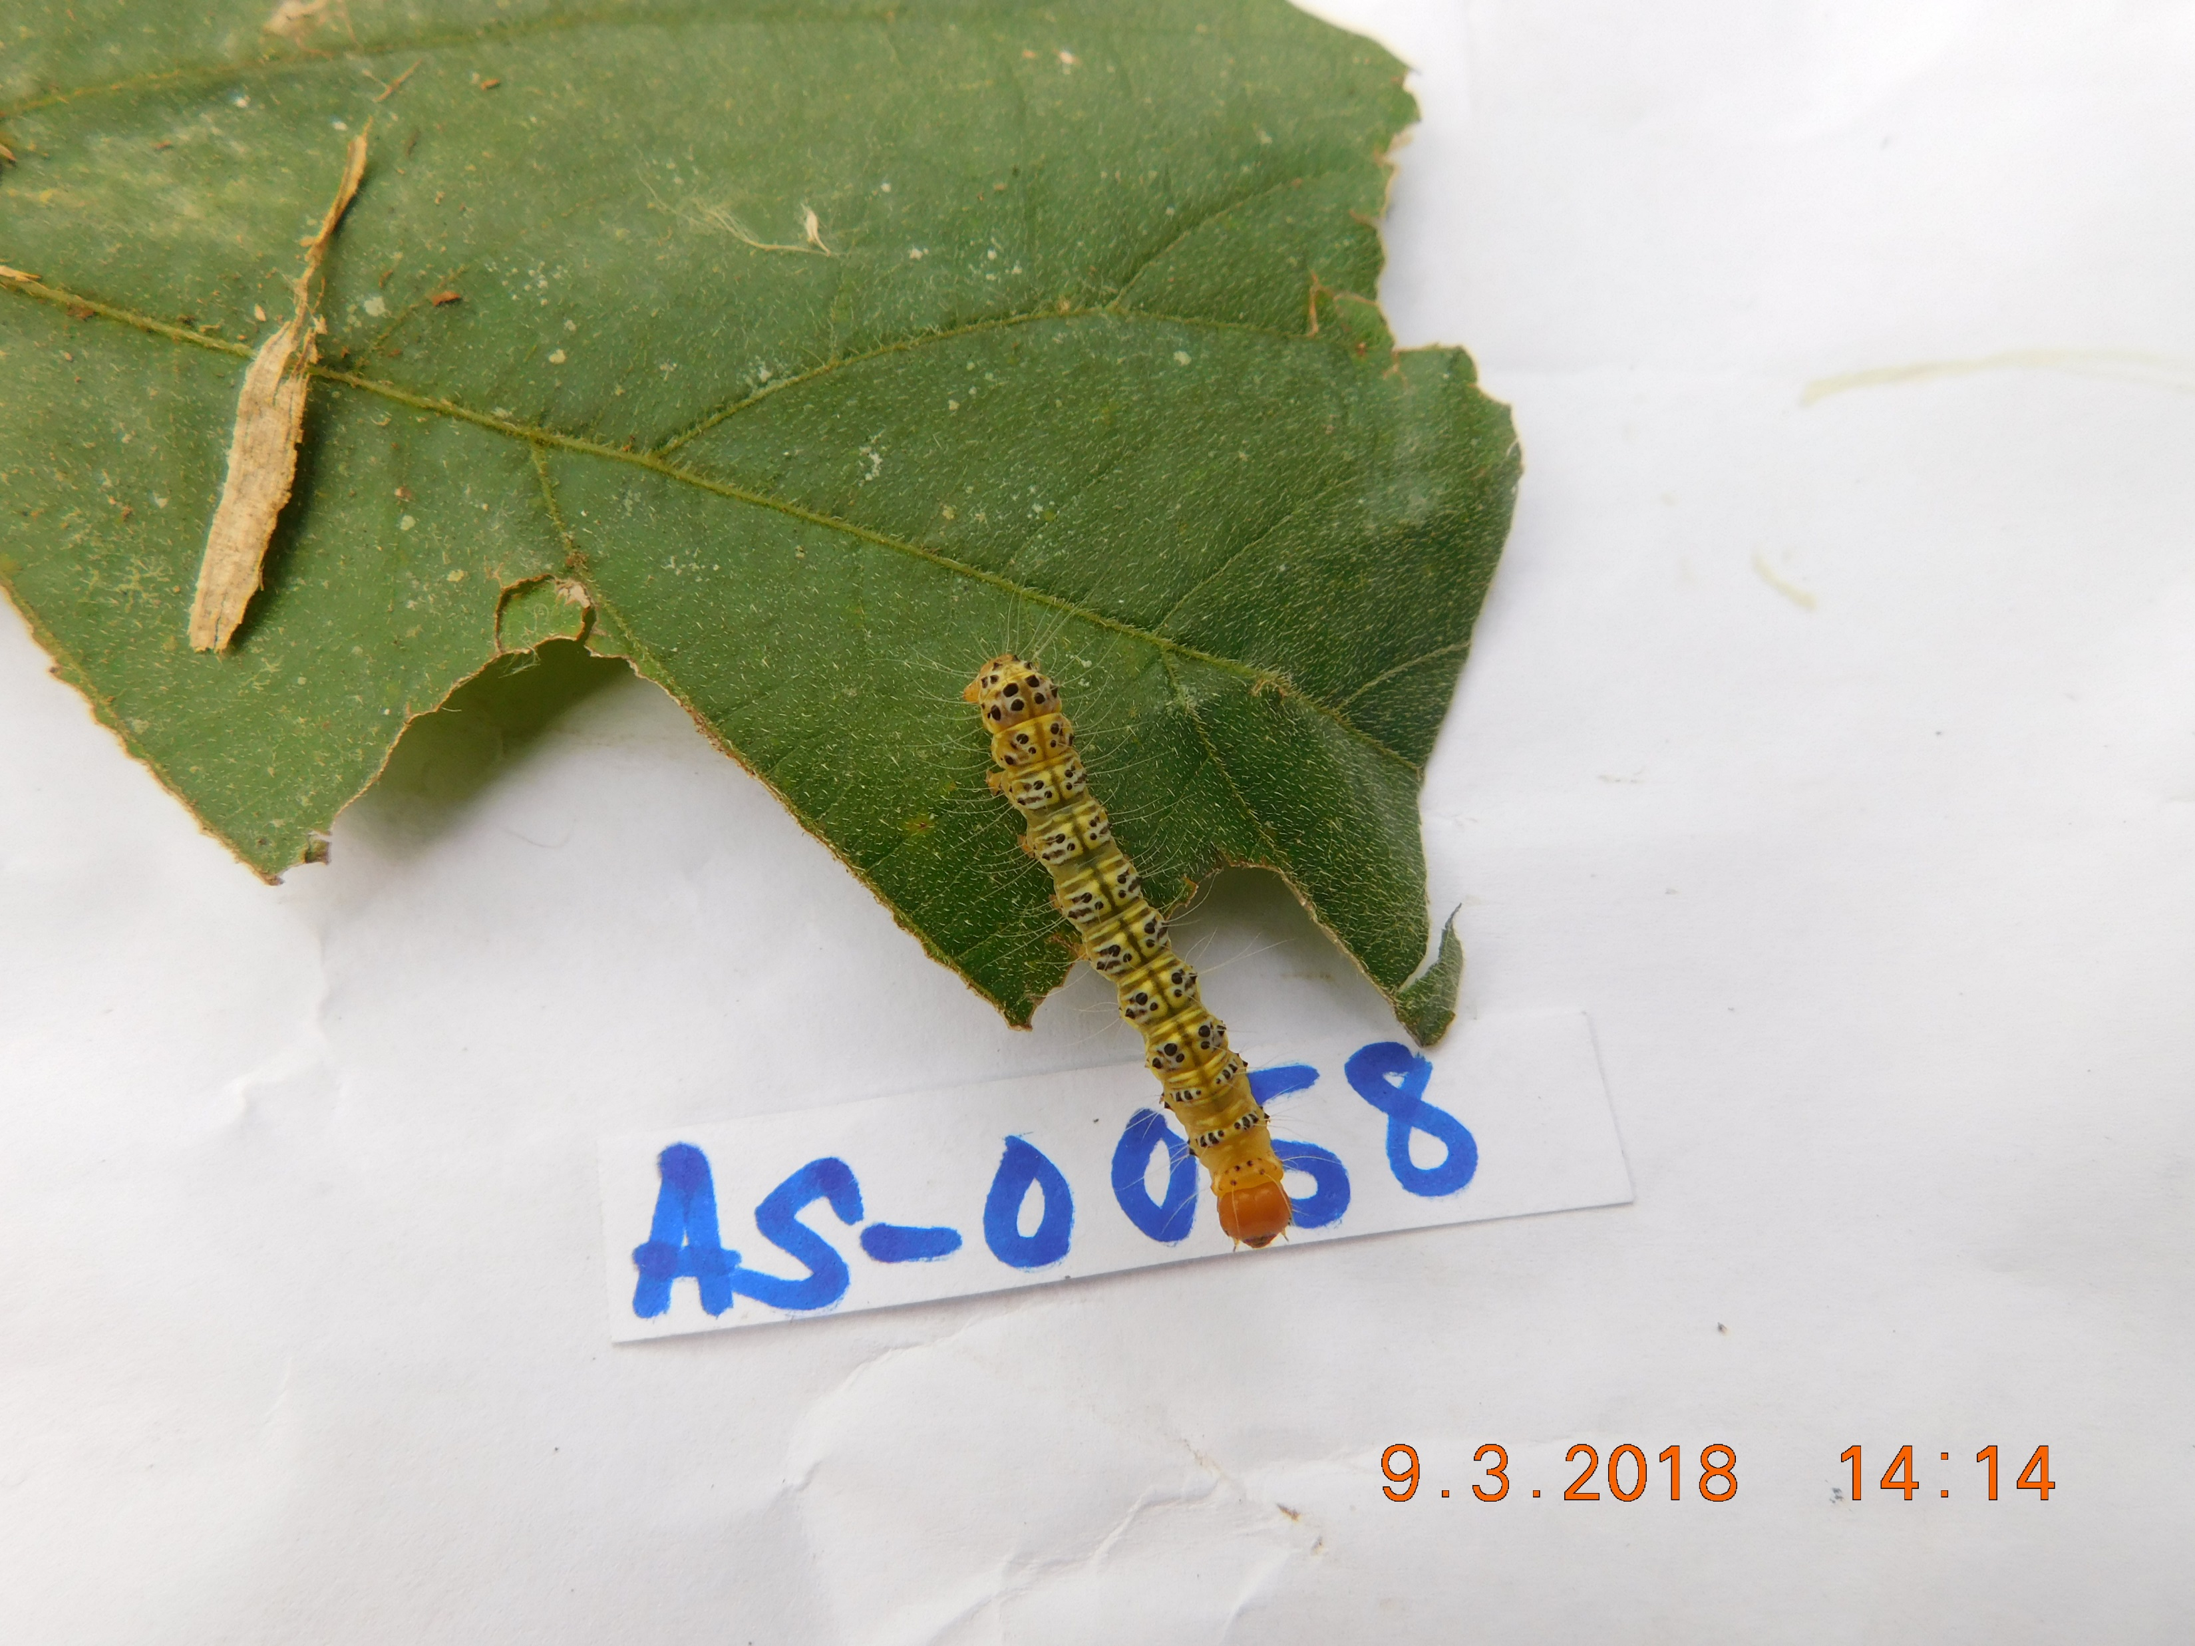
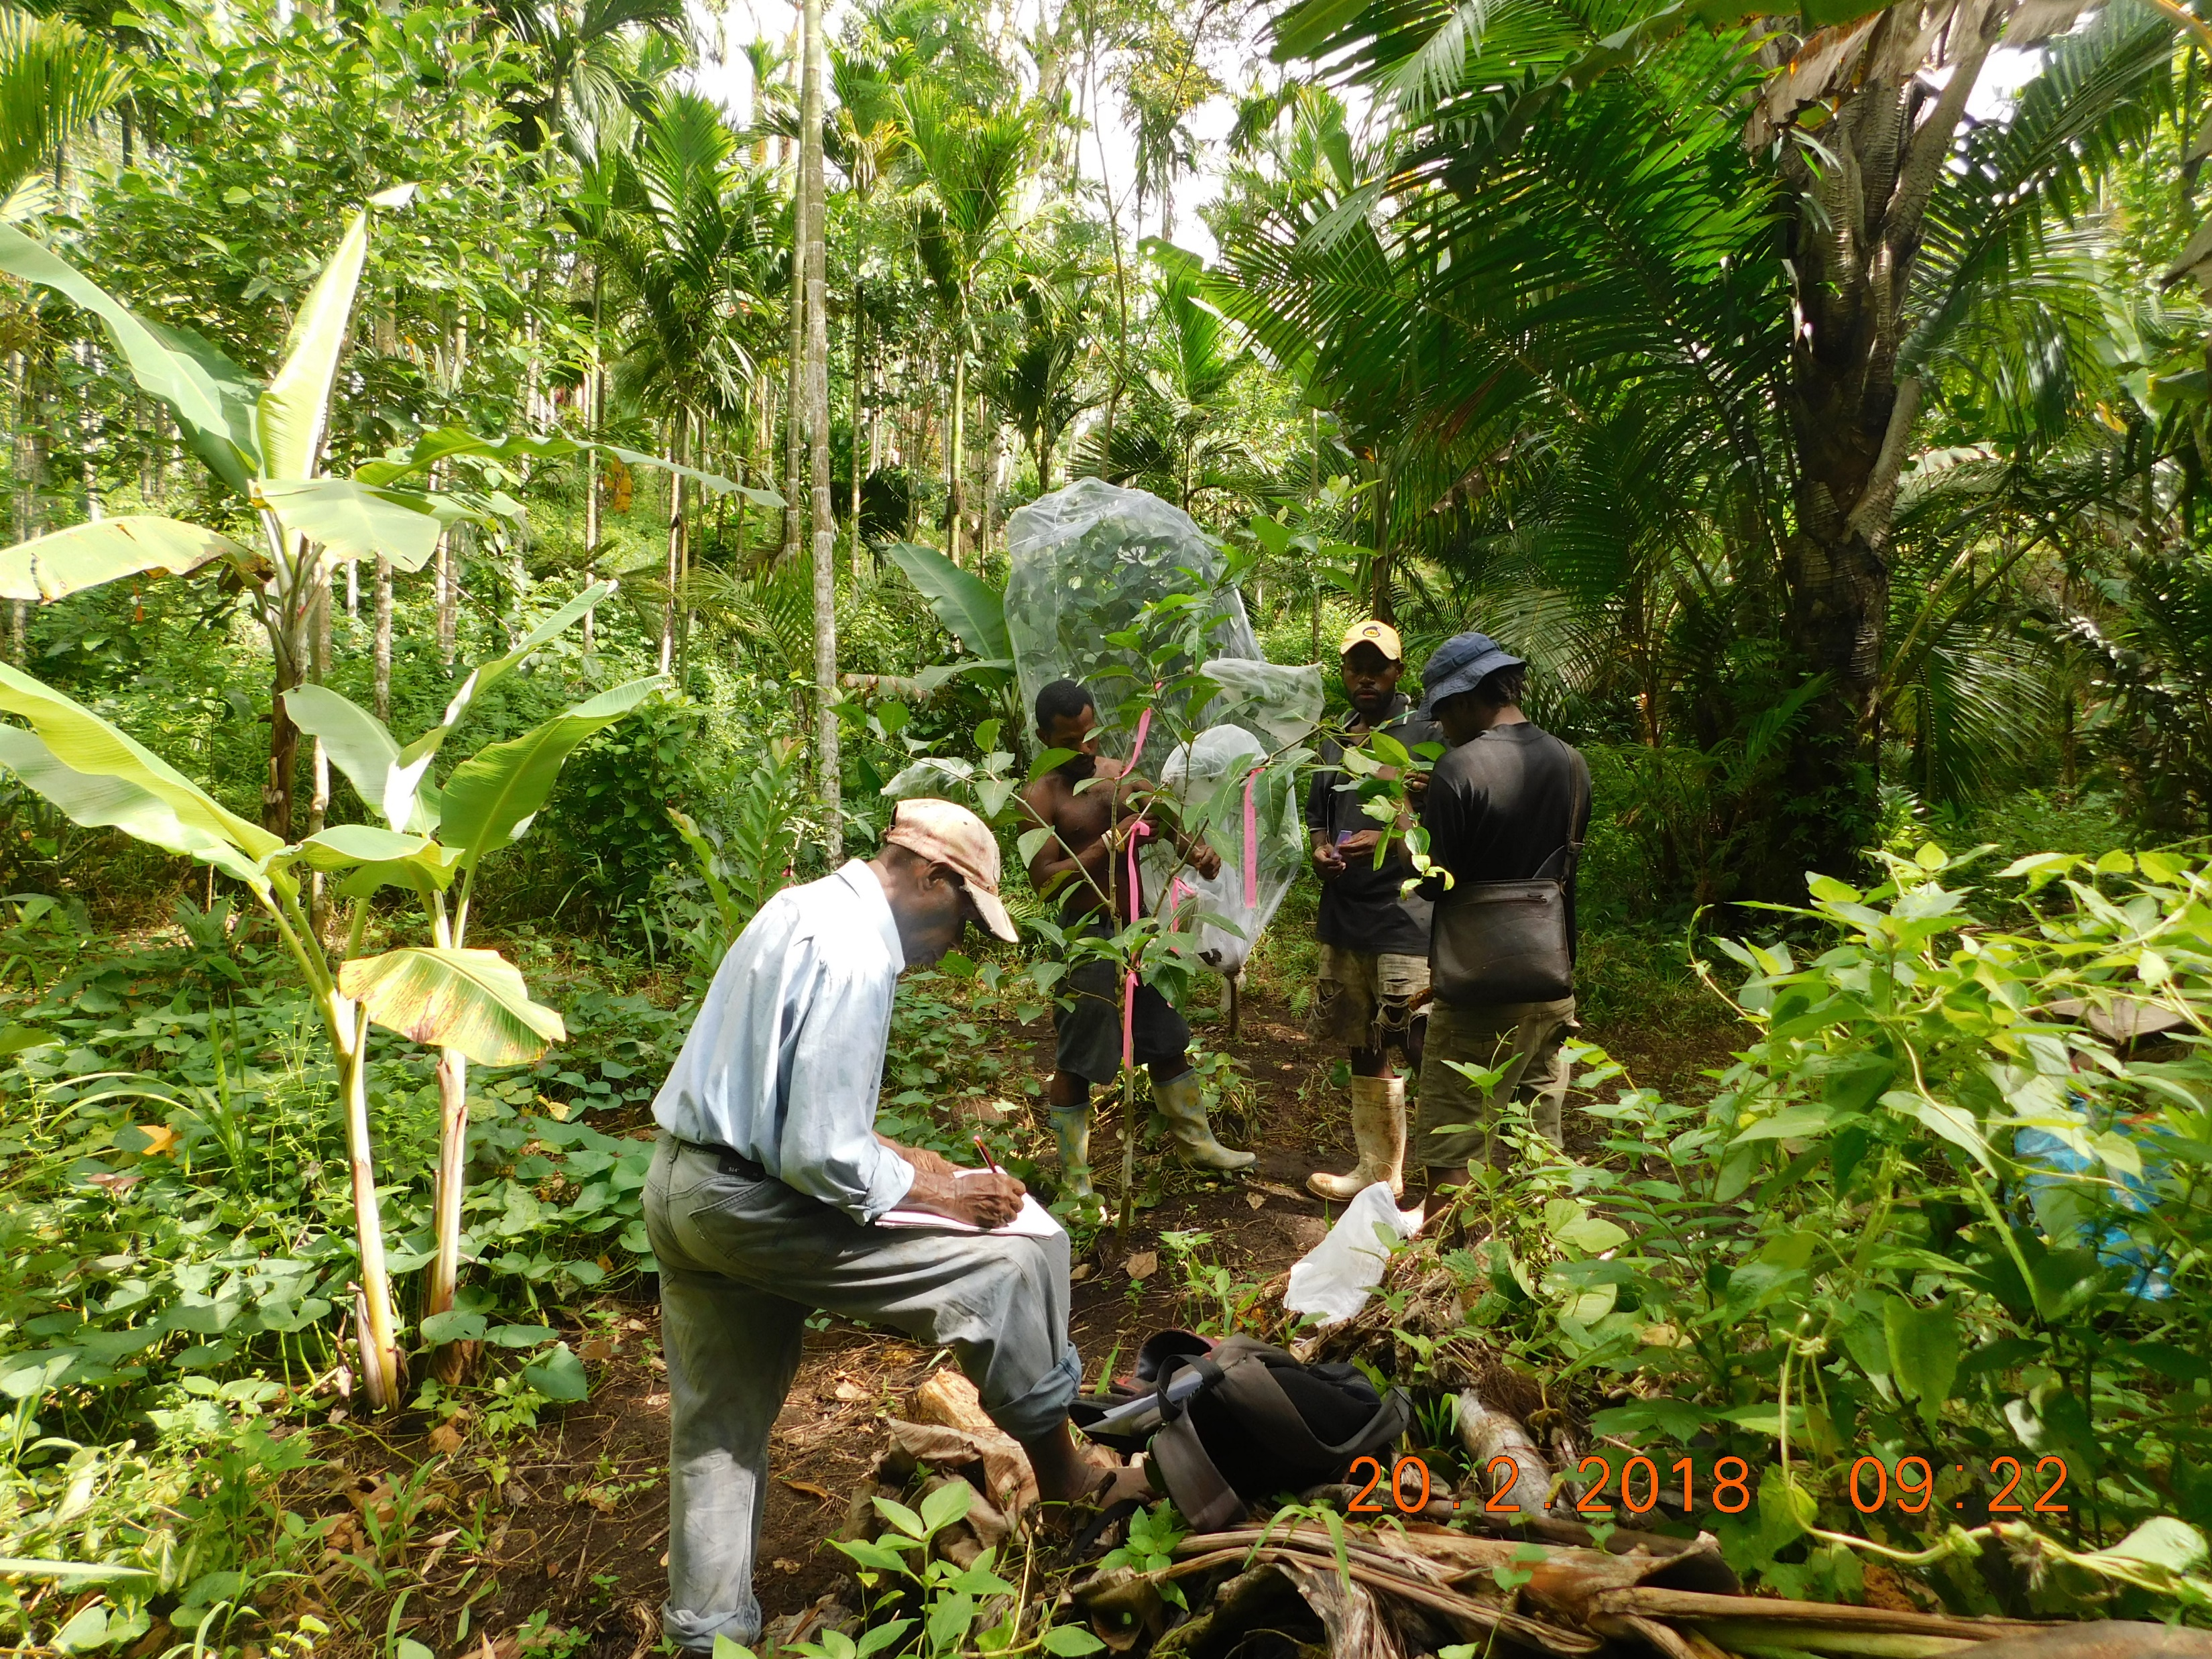
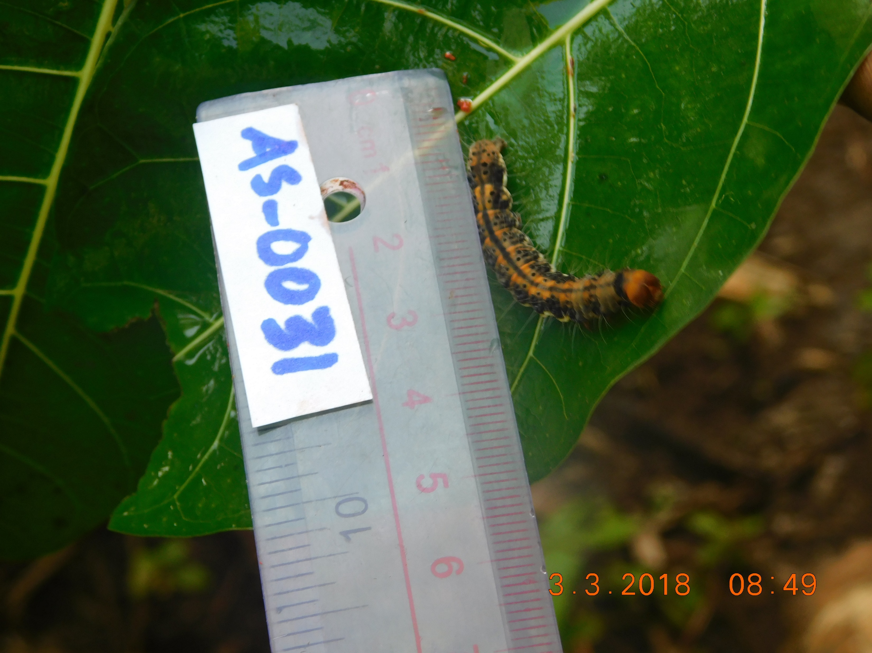
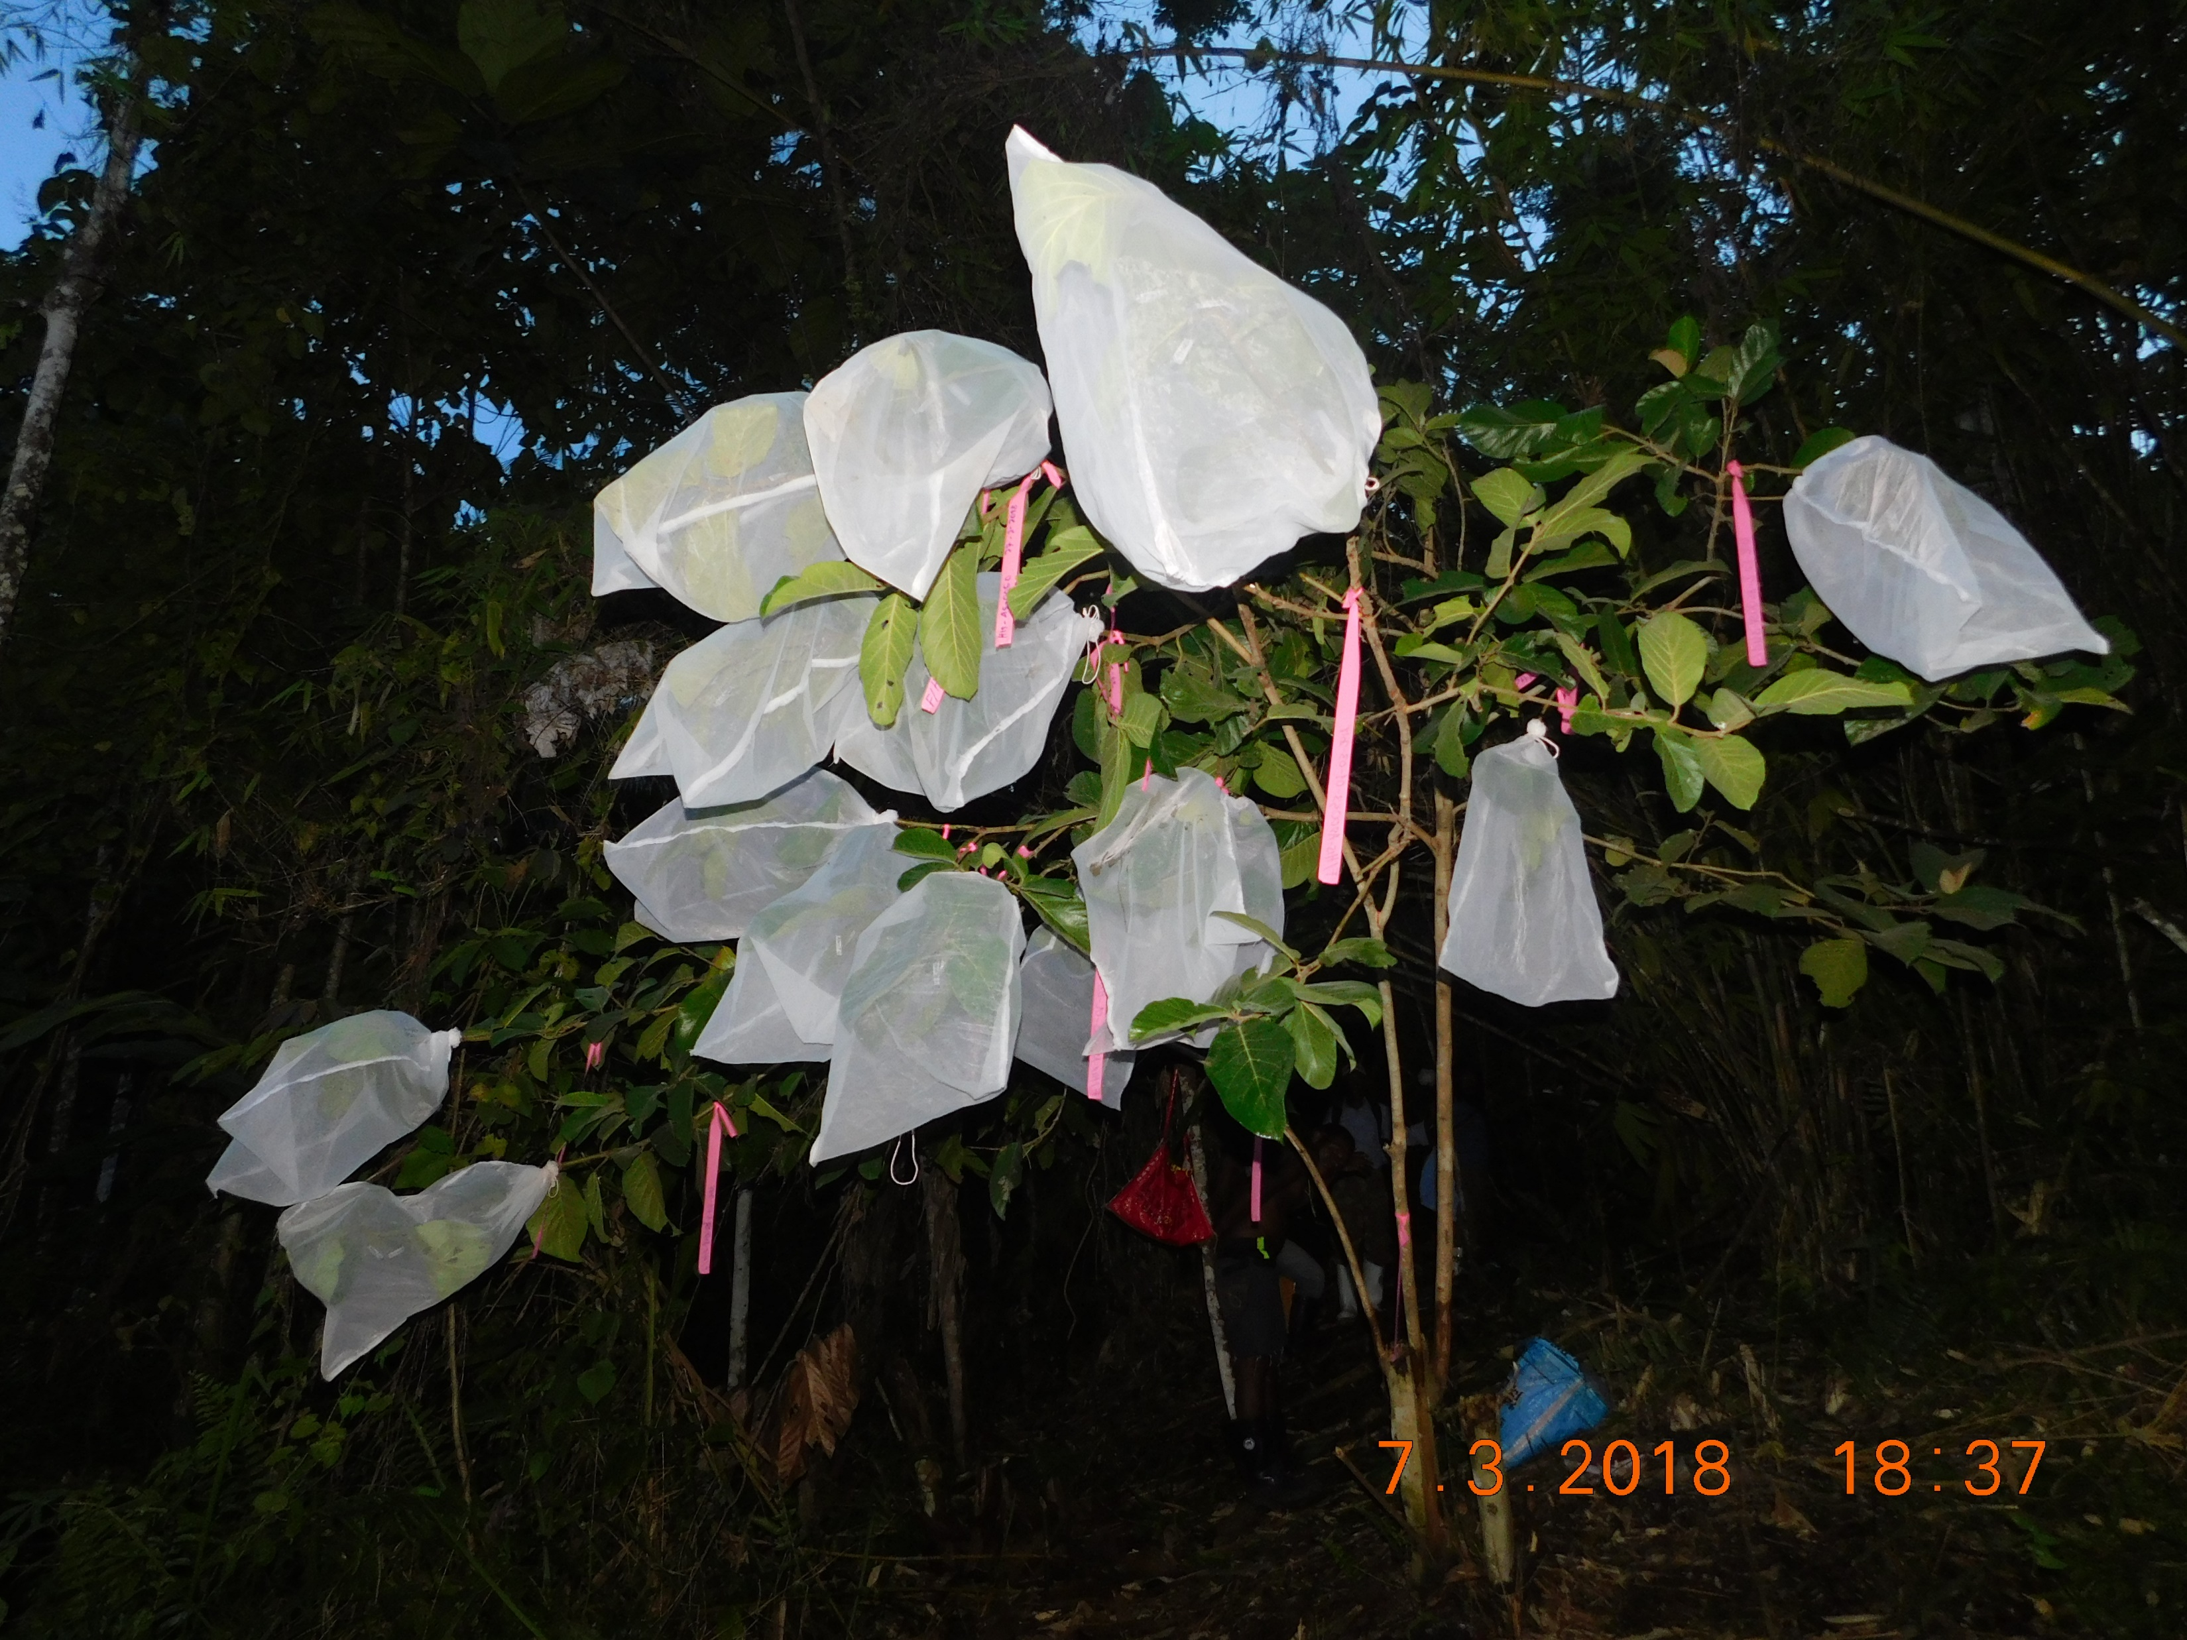
Asota eusemioides on Ficus hispidioides
Asota heliconia on Ficus septica

Slide 12
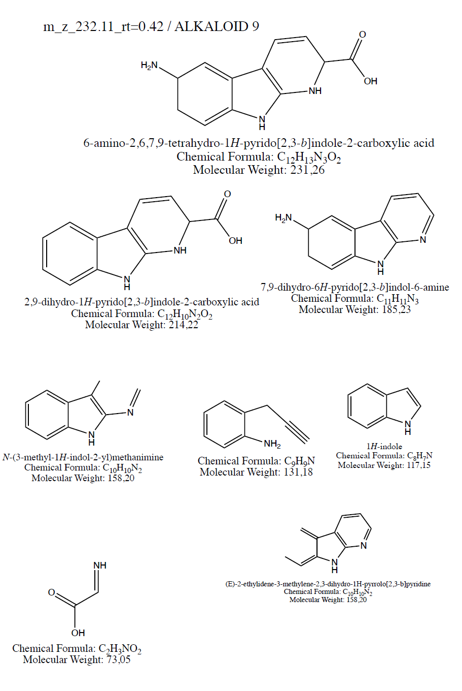
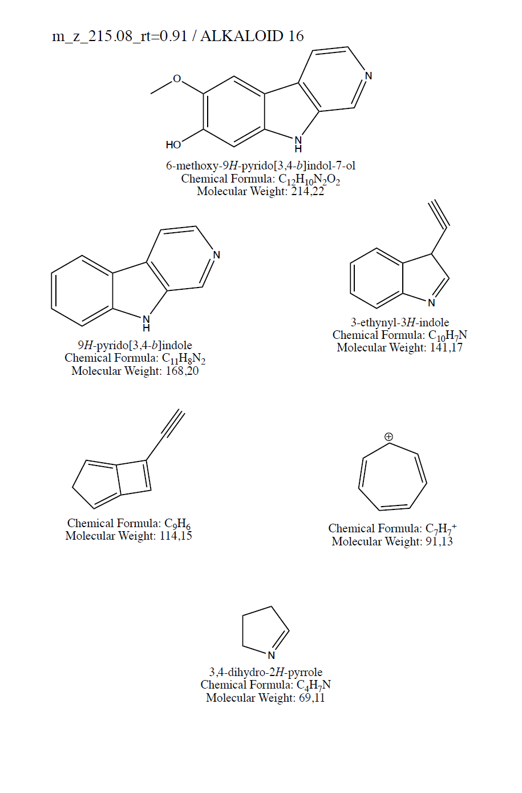

Slide 13
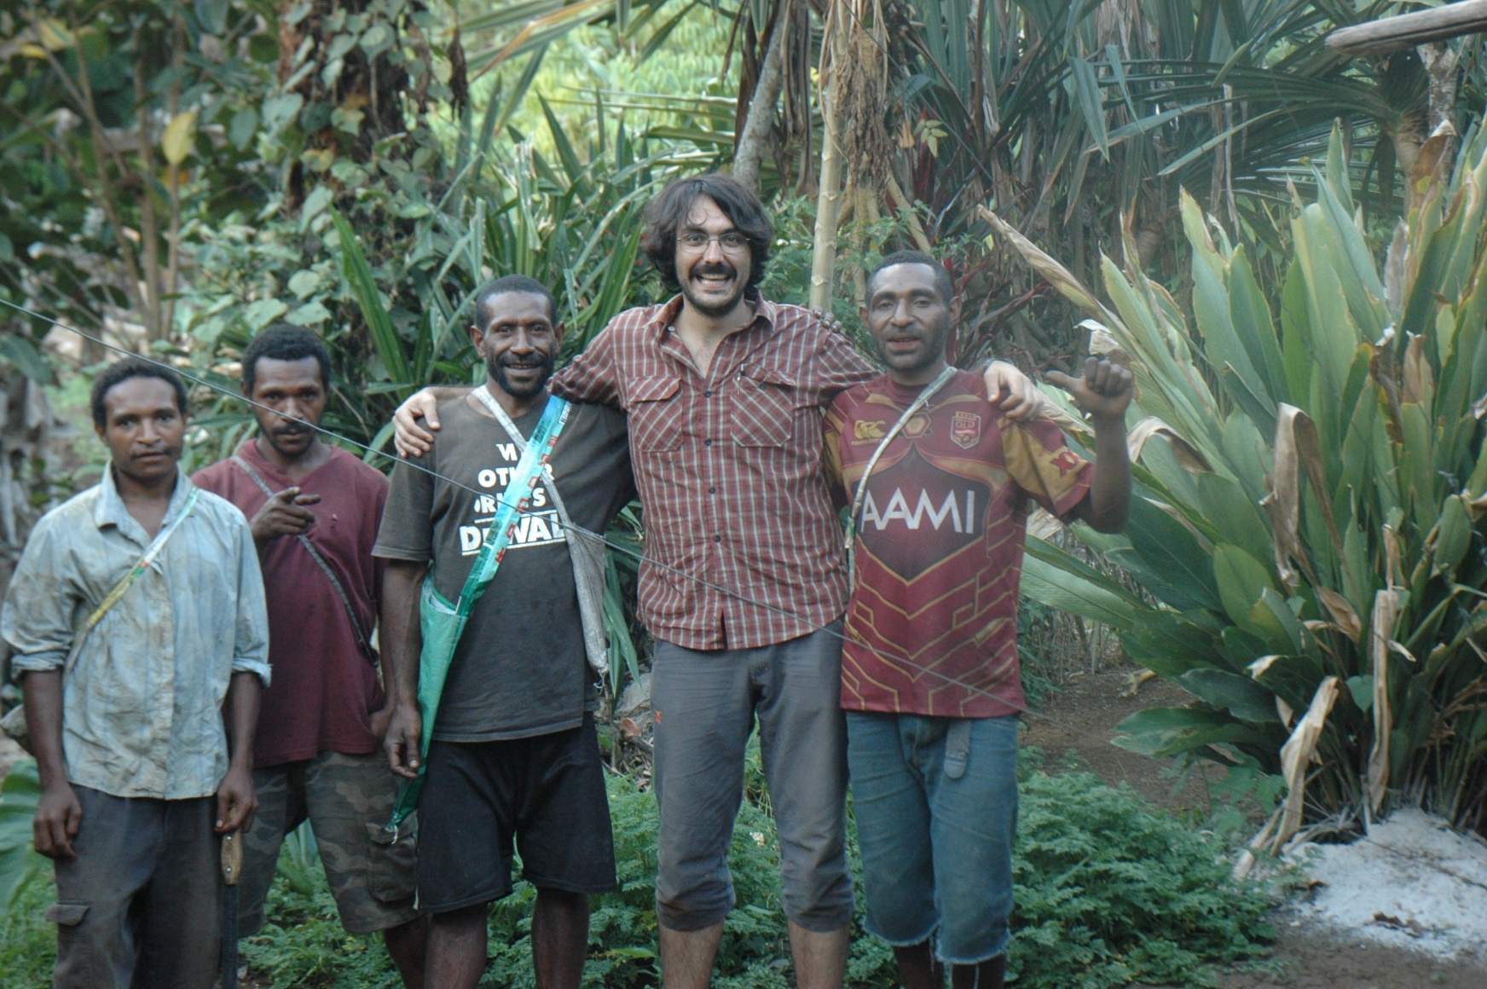
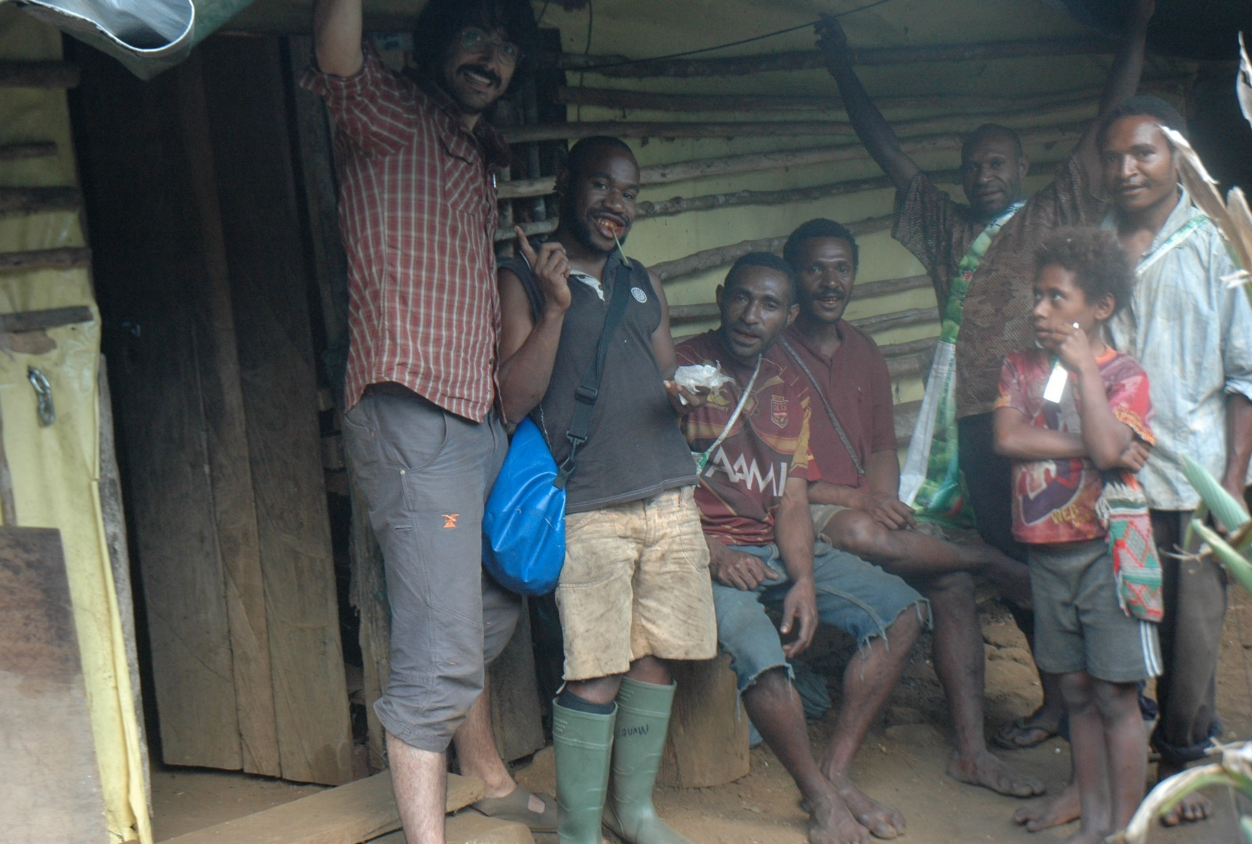
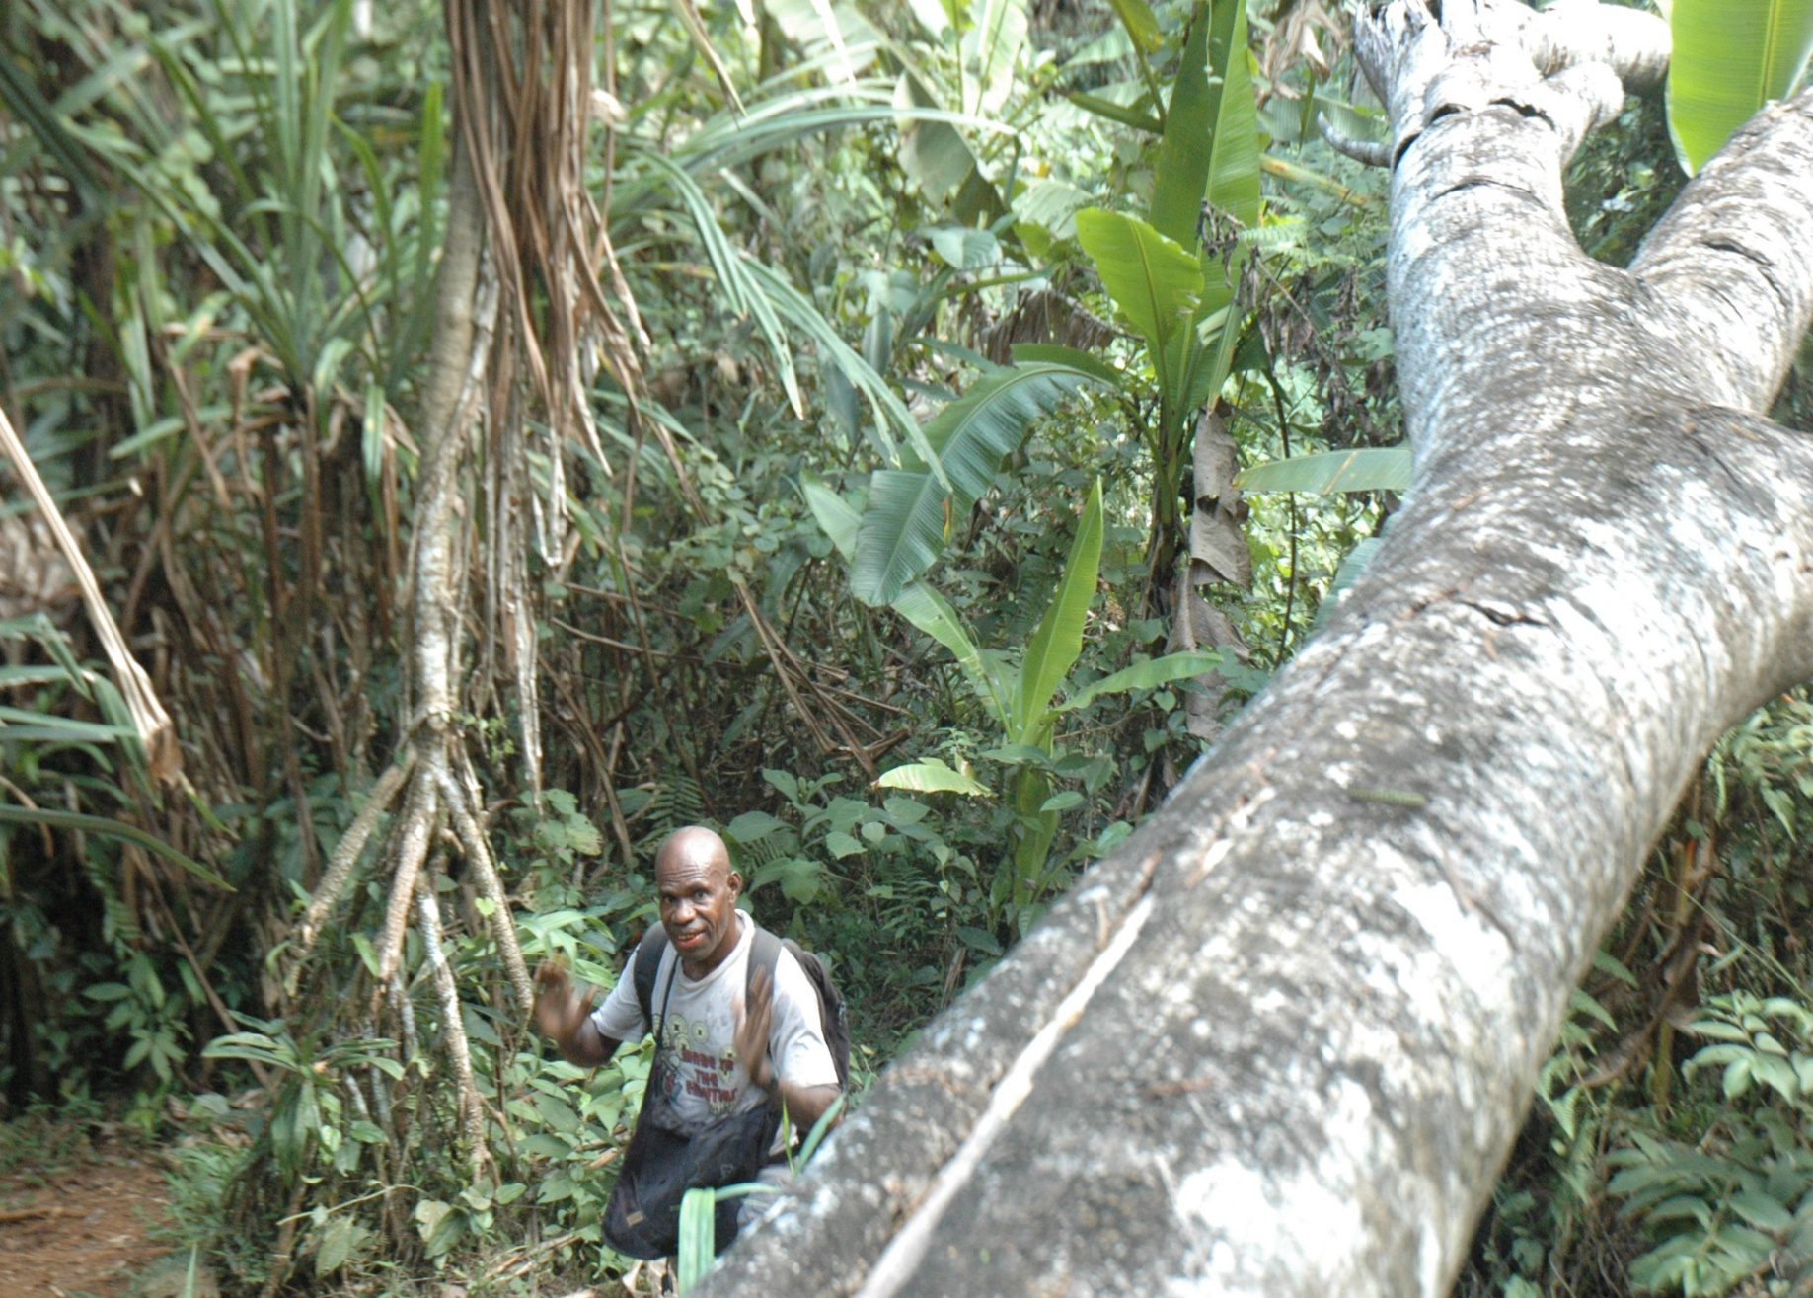
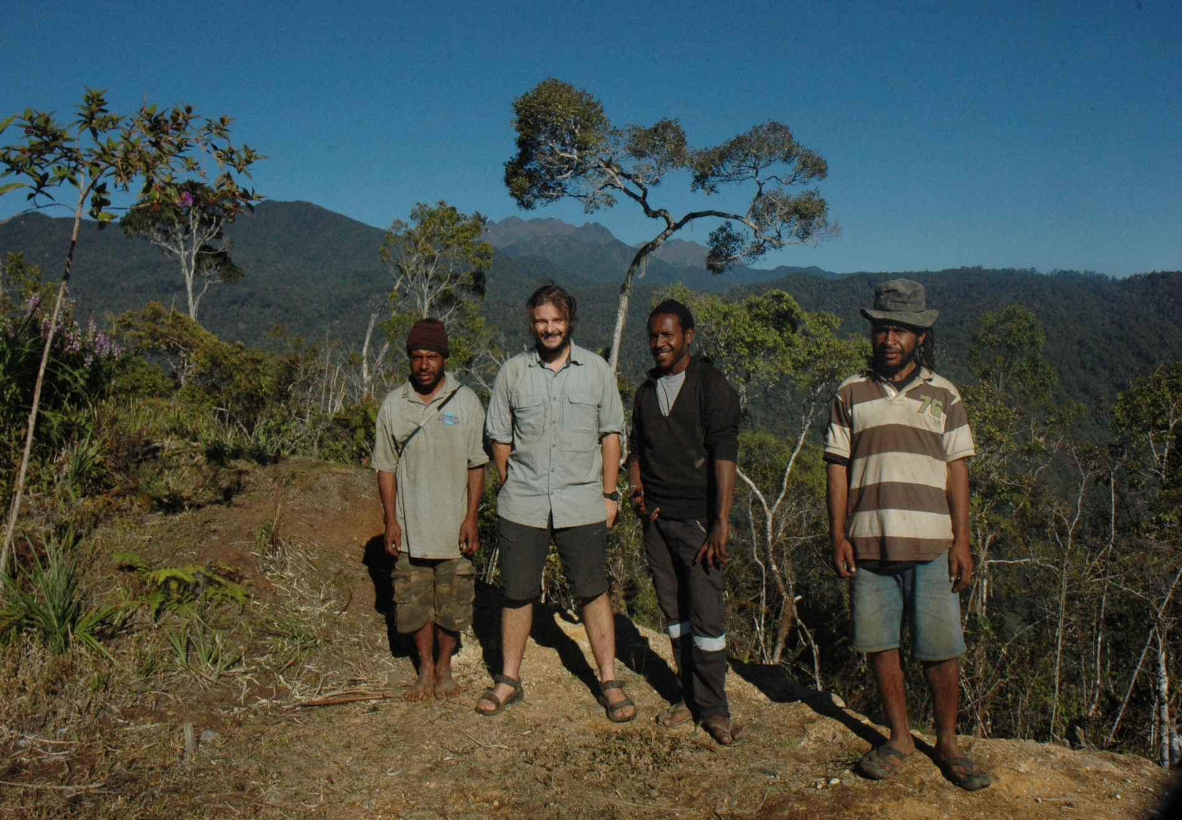

Slide 14
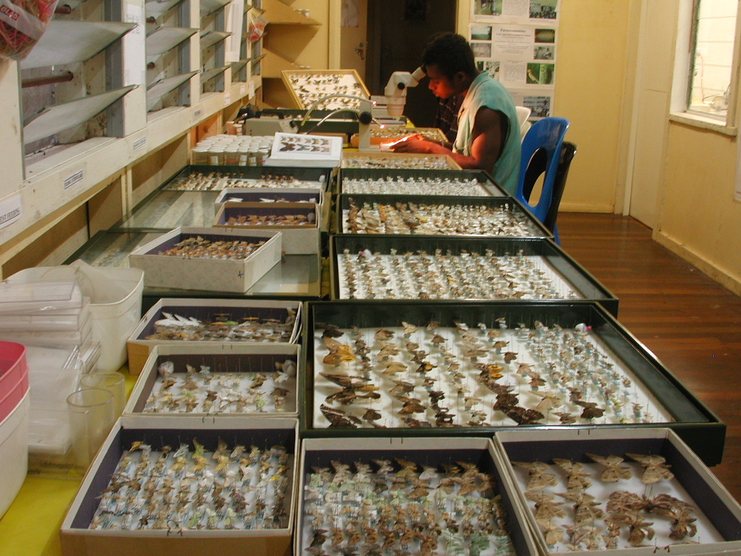

Slide 15
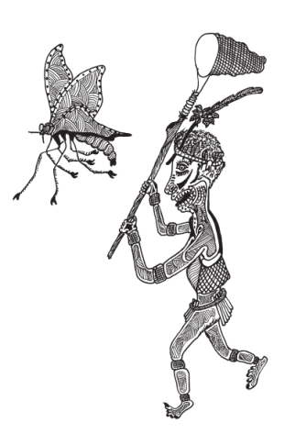
Questions?

